Slide 1
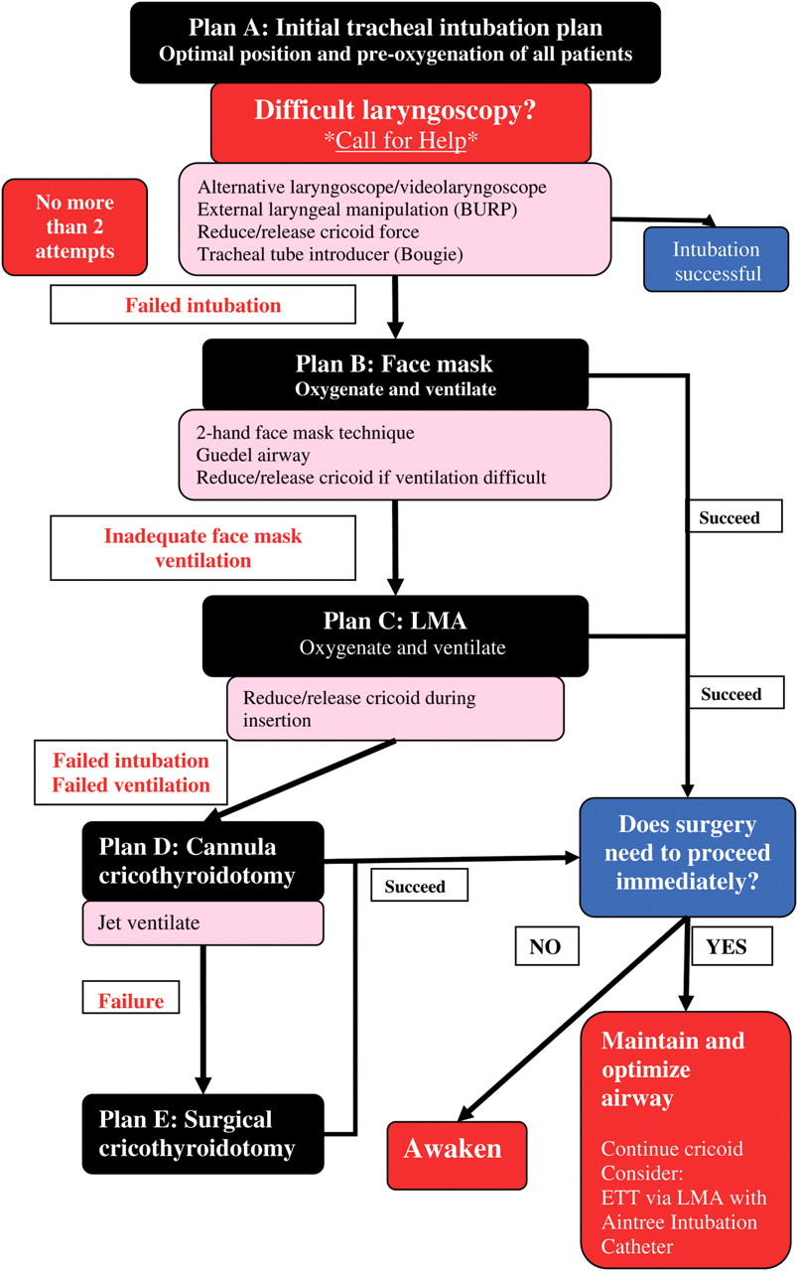

Failed obstetric intubation flowchart.
Rucklidge M , and Hinton C Contin Educ Anaesth Crit Care Pain 2012;12:86-91
© The Author [2012]. Published by Oxford University Press on behalf of the British Journal of Anaesthesia. All rights reserved. For Permissions, please email: journals.permissions@oup.com
Notes:
Failed obstetric intubation flowchart.

